Slide 1

Diabetes Prediction using Machine Learning Techniques
-Abhishek Kumar Pandit

Slide 2
Abstract
Diabetes is an illness caused because of high glucose level in a human body. Diabetes should not be ignored if it is untreated then Diabetes may cause some major issues in a person like: heart related problems, kidney problem, blood pressure, eye damage and it can also affects other organs of human body. Diabetes can be controlled if it is predicted earlier. To achieve this goal this project work we will do early prediction of Diabetes in a human body or a patient for a higher accuracy through applying, Various Machine Learning Techniques.

Slide 3
Machine learning techniques Provide better result for prediction by constructing models from datasets collected from patients. In this work we will use Machine Learning Classification and ensemble techniques on a dataset to predict diabetes. Which are Logistic Regression (LR), Support Vector Machine (SVM), Random Forest (RF). The accuracy is different for every model when compared to other models. The Project work gives the accurate or higher accuracy model shows that the model is capable of predicting diabetes effectively. Our Result shows that Random Forest achieved higher accuracy compared to other machine learning techniques.

Slide 4
INTRODUCTION
Diabetes is noxious diseases in the world. Diabetes caused because of obesity or high blood glucose level, and so forth. It affects the hormone insulin, resulting in abnormal metabolism of crabs and improves level of sugar in the blood. Diabetes occurs when body does not make enough insulin. According to (WHO) World Health Organization about 422 million people suffering from diabetes particularly from low or idle income countries. And this could be increased to 490 billion up to the year of 2030. However prevalence of diabetes is found among various Countries like Canada, China, and India etc. Population of India is now more than 100 million so the actual number of diabetics in India is 40 million. Diabetes is major cause of death in the world.

Slide 5
METHODOLOGY
Goal of the paper is to investigate for model to predict diabetes with better accuracy. We experimented with different classification and ensemble algorithms to predict diabetes. In the following, we briefly discuss the phase.
Distribution of Diabetic patient- We made a model to predict diabetes however the dataset was slightly imbalanced having around 500 classes labelled as 0 means negative means no diabetes and 268 labelled as 1 means positive means diabetic.

Slide 6
Data Pre-processing
Data pre-processing is most important process. Mostly healthcare related data contains missing vale and other impurities that can cause effectiveness of data. To improve quality and effectiveness obtained after mining process, Data pre-processing is done. To use Machine Learning Techniques on the dataset effectively this process is essential for accurate result and successful prediction. For Pima Indian diabetes dataset we need to perform pre processing in two steps.

Slide 7
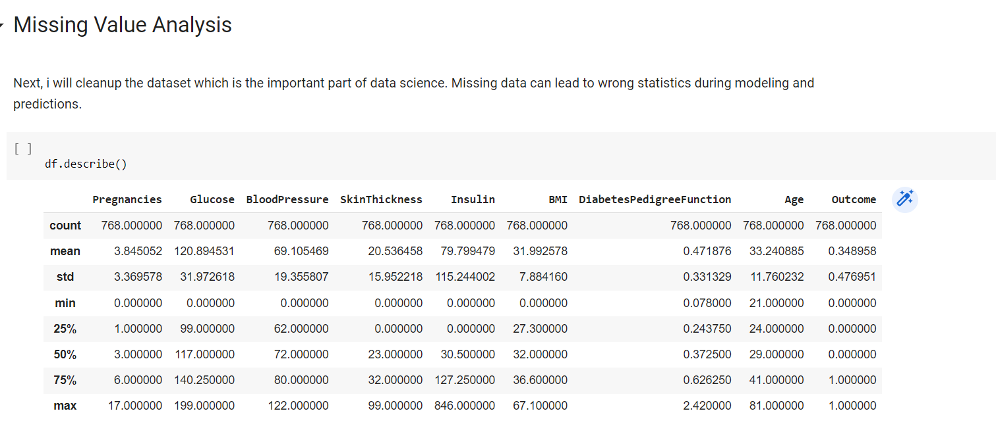

Slide 8
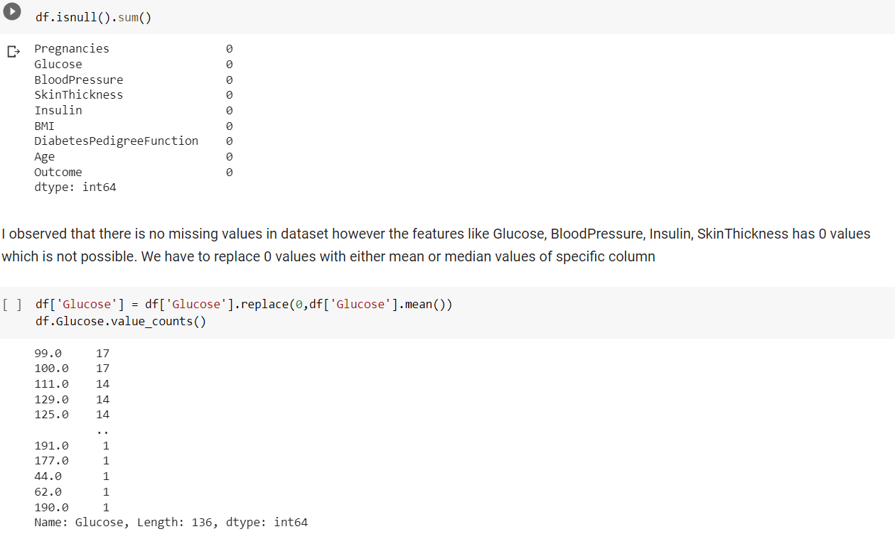

Slide 9

Apply Machine Learning
When data has been ready we apply Machine Learning Technique. We use different classification and ensemble techniques, to predict diabetes. The methods applied on Pima Indians diabetes dataset. Main objective to apply Machine Learning Techniques to analyze the performance of these methods and find accuracy of them, and also been able to figure out the responsible/important feature which play a major role in prediction. The Techniques are follows-

Slide 10
Support Vector Machine
Logistic Regression
Random Forest

Slide 11
MODEL BUILDING
This is most important phase which includes model building for prediction of diabetes. In this we have implemented various machine learning algorithms which are discussed above for diabetes prediction

Slide 12
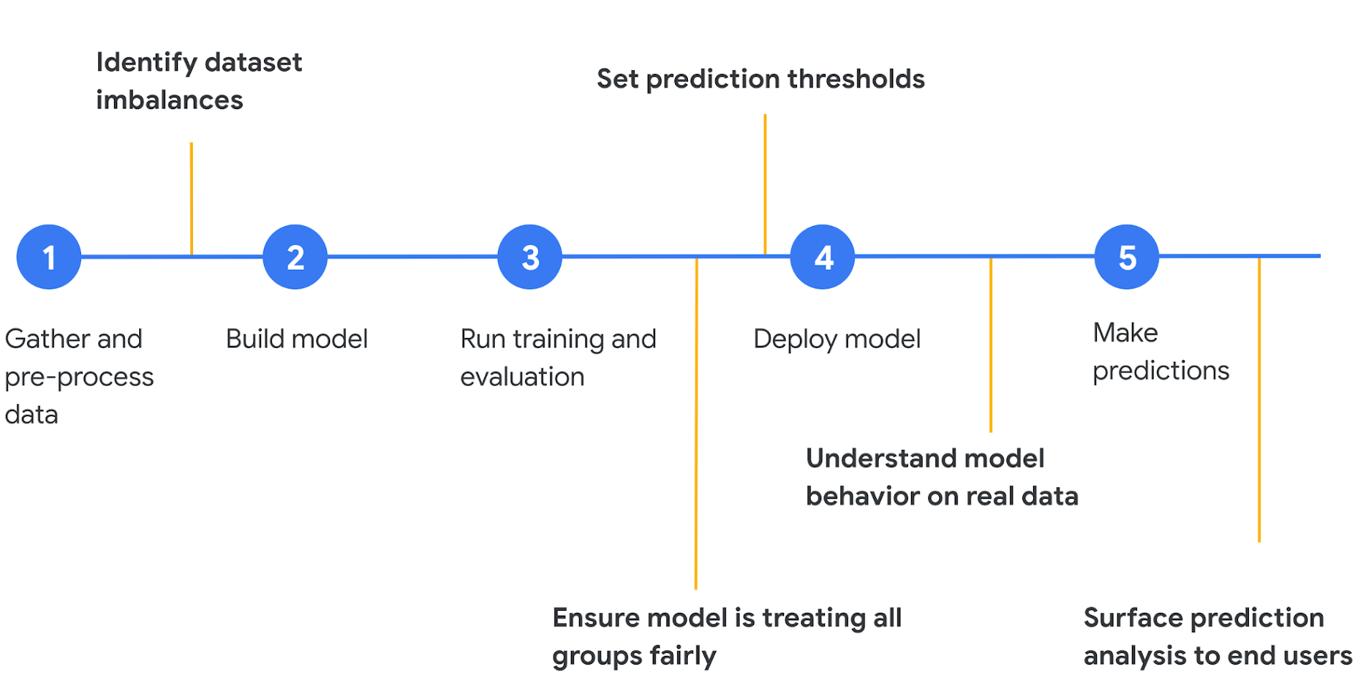

Slide 13
Procedure of Proposed Methodology
Step1: Import required libraries, Import diabetes dataset.
Step2: Pre-process data to remove missing data.
Step3: Perform percentage split of 80% to divide dataset as Training set and 20% to Test set.
Step4: Select the machine learning algorithm i.e. Support Vector Machine, regression, Random Forest algorithm.
Step5: Build the classifier model for the mentioned ma- chine learning algorithm based on training set.
Step6: Test the Classifier model for the mentioned ma- chine learning algorithm based on test set.
Step7: Perform Comparison Evaluation of the experimental performance results obtained for each classifier.
Step8: After analyzing based on various measures conclude the best performing algorithm.

Slide 14
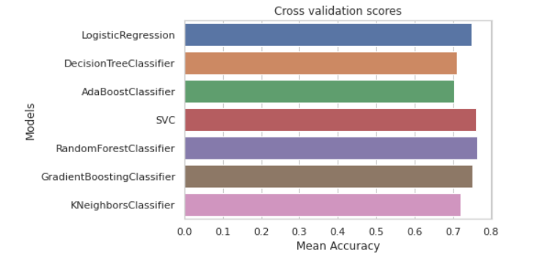
Mean Accuracy of various algorithm

Slide 15
EXPERIMENTAL RESULTS
In this work different steps were taken. The proposed approach uses different classification and ensemble methods and implemented using python. These methods are standard Machine Learning methods used to obtain the best ac- curacy from data. In this work we see that random forest classifier achieves better compared to others. Overall we have used best Machine Learning techniques for prediction and to achieve high performance accuracy.

Slide 16
CONCLUSION
The main aim of this project was to design and implement Diabetes Prediction Using Machine Learning Methods and Performance Analysis of that methods and it has been achieved successfully. The proposed approach uses various classification and ensemble learning method in which SVM, Random Forest, Logistic Regression And 77% classification accuracy has been achieved.

